Slide 1

Flamingo
A Visual Language Model for Few-Shot Learning
J-B Alayrac et al., DeepMind, NeurIPS (2022)
Group 47, CSCI 544, Fall 2023

Slide 2
Contents
Introduction - What is Flamingo, Motivation and Challenges
Flamingo Model - Approach, Architecture and Components
Dataset and Experiment
Related Work
Limitations
Notes:
NOTES

Slide 3
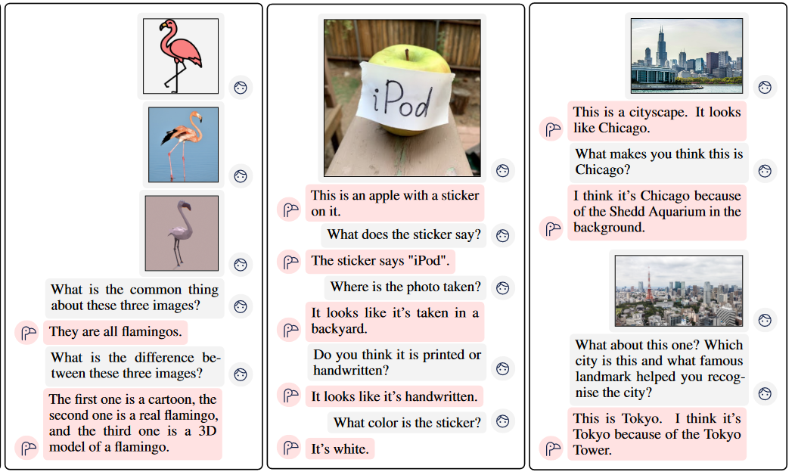
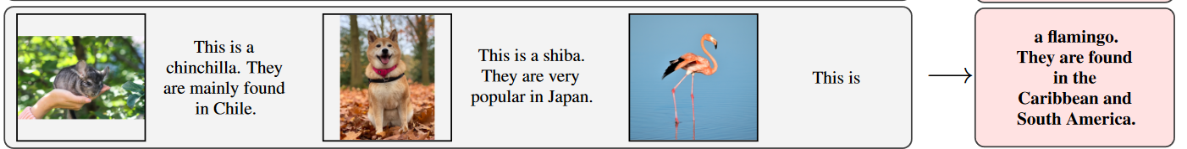
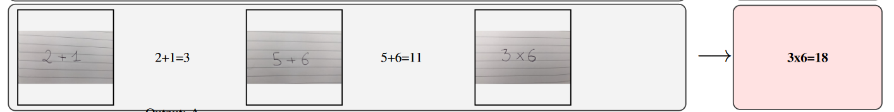
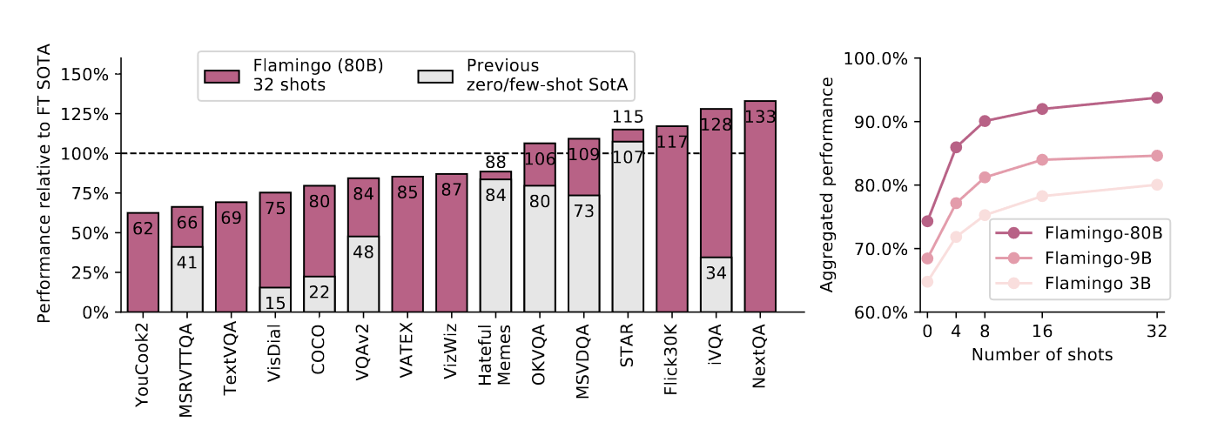
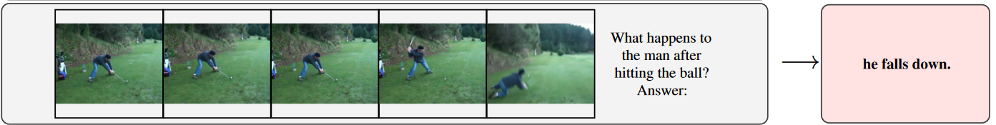
🦩 Introduction - What is Flamingo
Goal: Generalist Visual Language Model adaptable to different multimodal tasks with few-shot learning
VLM: input visual data (image/video) along with language, produce language output
Variety of multimodal tasks (captioning, visual conversation, classification) with same weights
Few shot: Needs only a few input-output examples to learn a new task
Notes:
Image and Text Inputs
Describe images with location in example, Flamingo learns to recognize the animal/bird and the location
Simple OCR: Recognize numbers in the image and compute the equation
Video input: handle sequences of arbitrarily inter-leaved visual and textual data, dialog
Also provides a chat-like interface - multiple images and text inputs interleaved

Slide 4


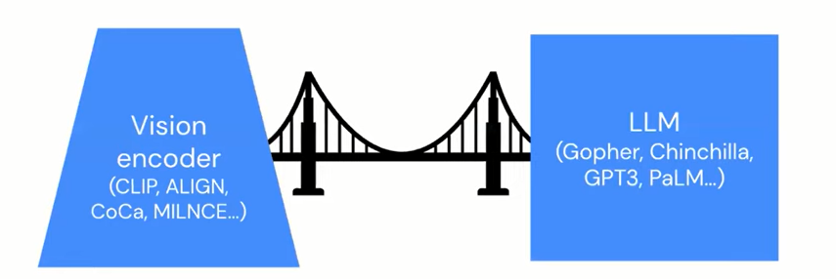
🦩 Introduction - Motivation & Challenges
Motivation behind Flamingo
Do more with less data (meta-learning) and computation (meta-reasoning), inspired by the human mind 🧠
Ability to quickly learn to perform a new task given a short instruction, similar to how children learn new categories/labels 👶🏽
Stand on the shoulder of giants by using large pre-trained models 👀⚙️ + 🔤⚙️
Challenges of Multimodal Generative Models
Combine strong uni-modal models. Start from pre-trained, use cross-attention layers and gating ❎🛎️
Treat image and video the same. High to Low dimensions using perceiver 📷 = 📽️
Heterogeneous training data. Existing data (from CLIP, ALIGN) is not general enough. Scrape web with interleaved text and image pairs
Notes:
Doing more with less:
Meta-Learning (modeling the learning environment to make better use of limited data)
Meta-Reasoning (deciding how to allocate computational resources)
Stand on the shoulder of giants
Existing multimodal models like CLIP, ALIGN cannot generate language. Existing VLMs with language generation like VL-T5 do not have few shot capabilities
Key questions AFTER motivation
Can we train a multimodal model to work well in a "few-shot" regime?
Can we we learn a model capable of open-ended multimodal tasks via pretraining?
Challenges
Cross Attention: Interleave cross-attention layers with (regular language-only) self-attention layers - that are kept frozen during training. A gating mechanism - to minimize the effect of these newly added layers at initialization - improves stability and final performance.
Image and Video the same: Use a Perceiver-based architecture - produce a small fixed number of visual tokens (around a hundred) per image/video, given a large varying number of visual input features (up to several thousand).
Heterogenous training data: scrape/create an interleaved dataset image/text and video/text pairs that are more strongly related

Slide 5
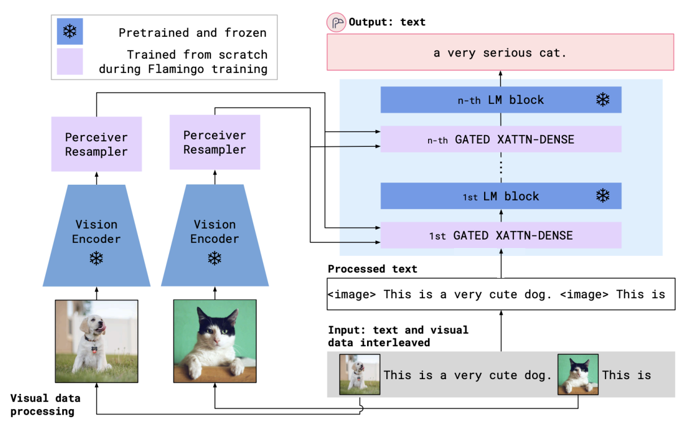
🦩 Model Architecture
Notes:
Pictures to image tags
Start of sentence tags
End of sentence tags

Slide 6
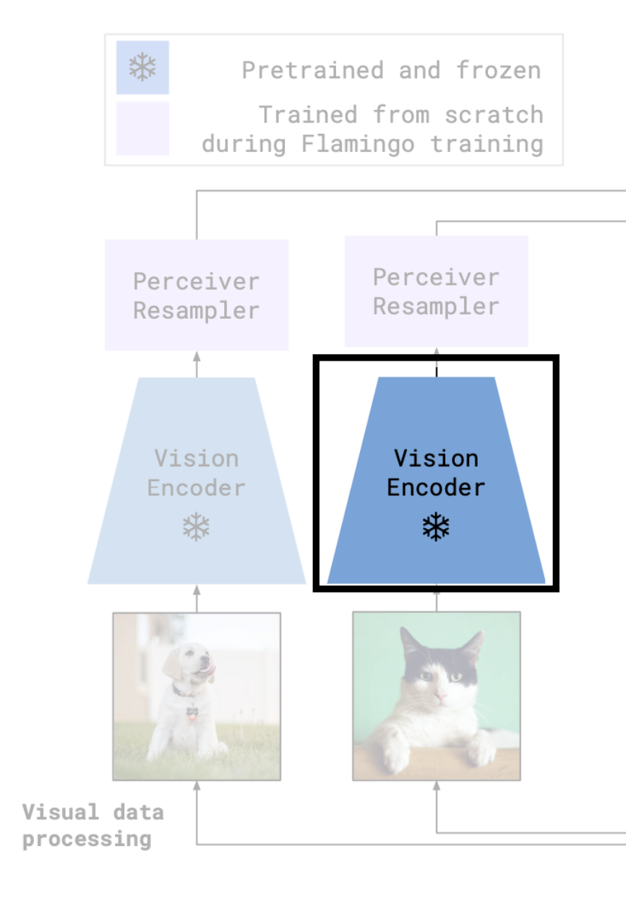
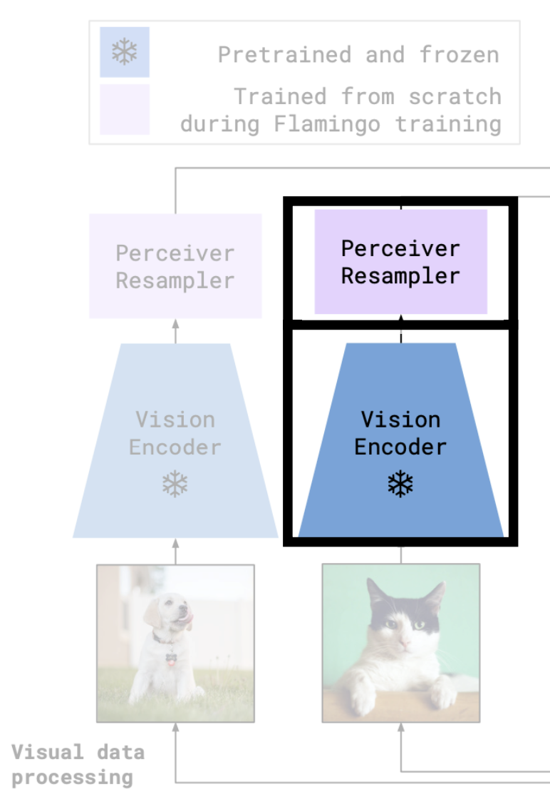
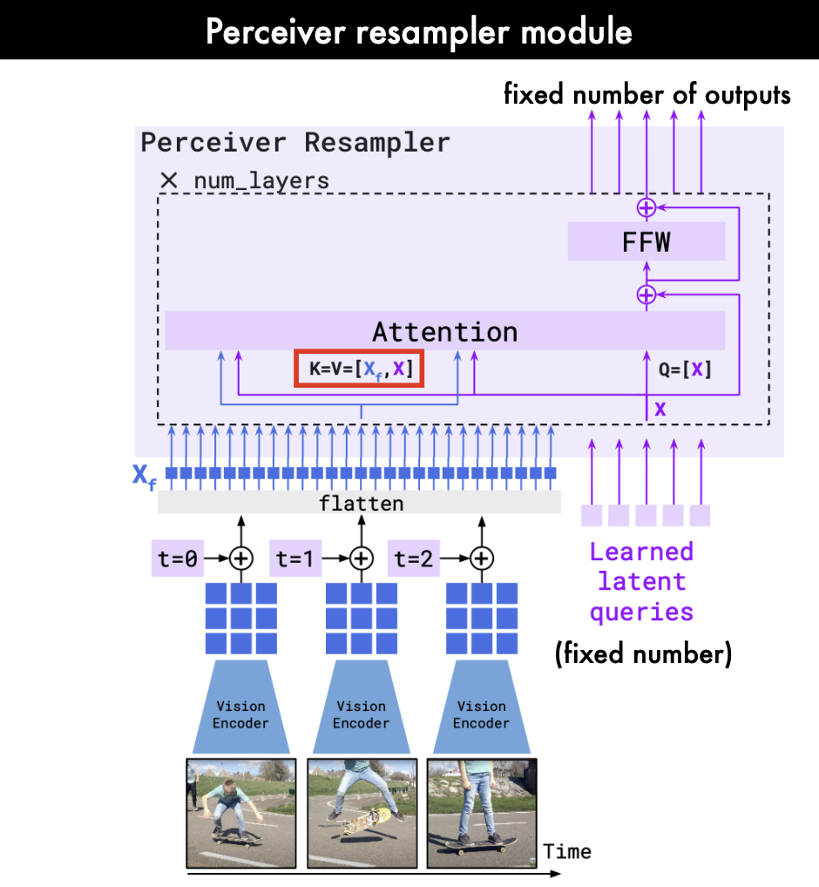
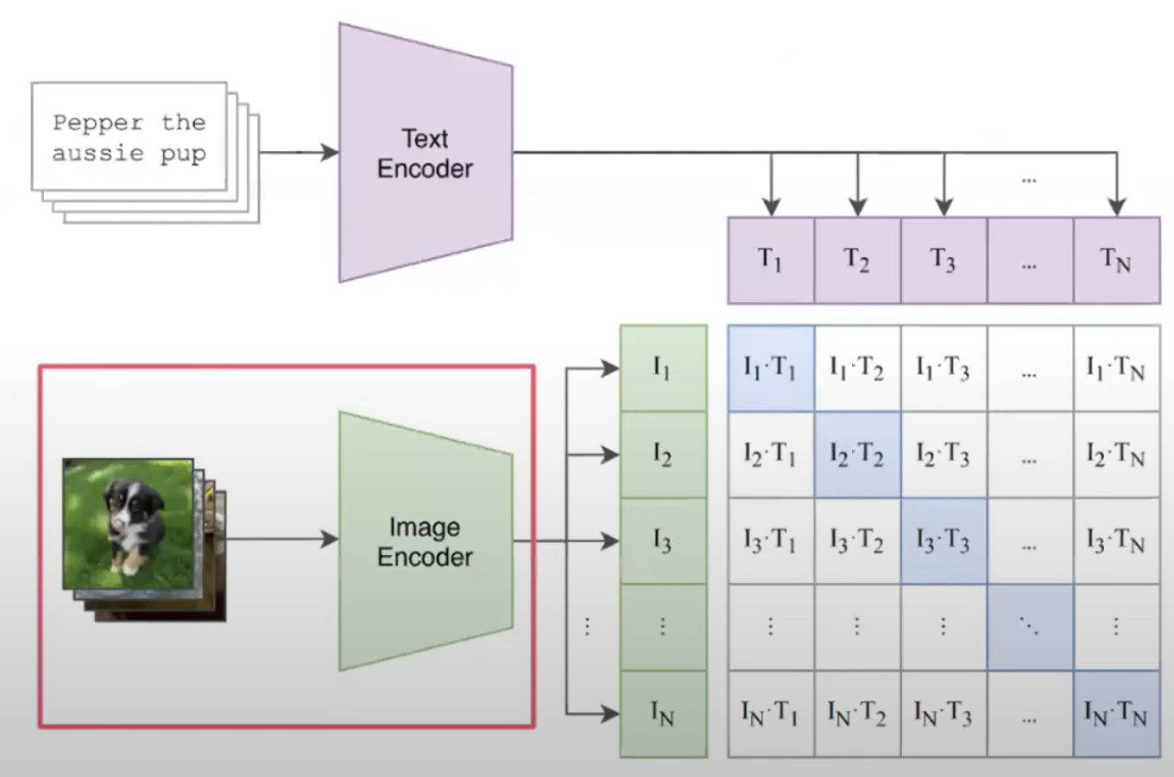
🦩 Model Architecture - Processing Vision
Notes:
Vision encoder:
Pretrained Frozen F6 Normalizer-Free ResNet (NFNet)
Datasets: Text-Image dataset ALIGN (1.8 billion) - noisy LTIP (312 million) - cleaner, longer descriptions
Contrastive Loss as used in CLIP (Data Merge Accumulation and Round Robin)
Train basically only extract the vision encoder and we discard the text encode
For videos: frames are sampled at 1FPS (features are concatenated
Outputs 2D spatial grid of features which is flattened to 1D of dimensions 1376
Perceiver Resampler
A variable number of input frames are processed (for videos) could be upto 1000 images
the vision encoder thus produces a variable number of features It outputs a fixed number of visual tokens (64) to limit complexity
Temporal encodings are added to visual inputs The results are then flattened to form a 1D sequence
These are combined with a fixed set of learned latent queries (64) Both are processed by attention and feed-forward layers.
Both are processed by attention and feed-forward layers.
Keys and Values by vision encoder and Queries Learned Latent
Learn latent queries and only cross attend to a large number of visual features to then only extract a fixed number of features
Output is 64 dim vector

Slide 7
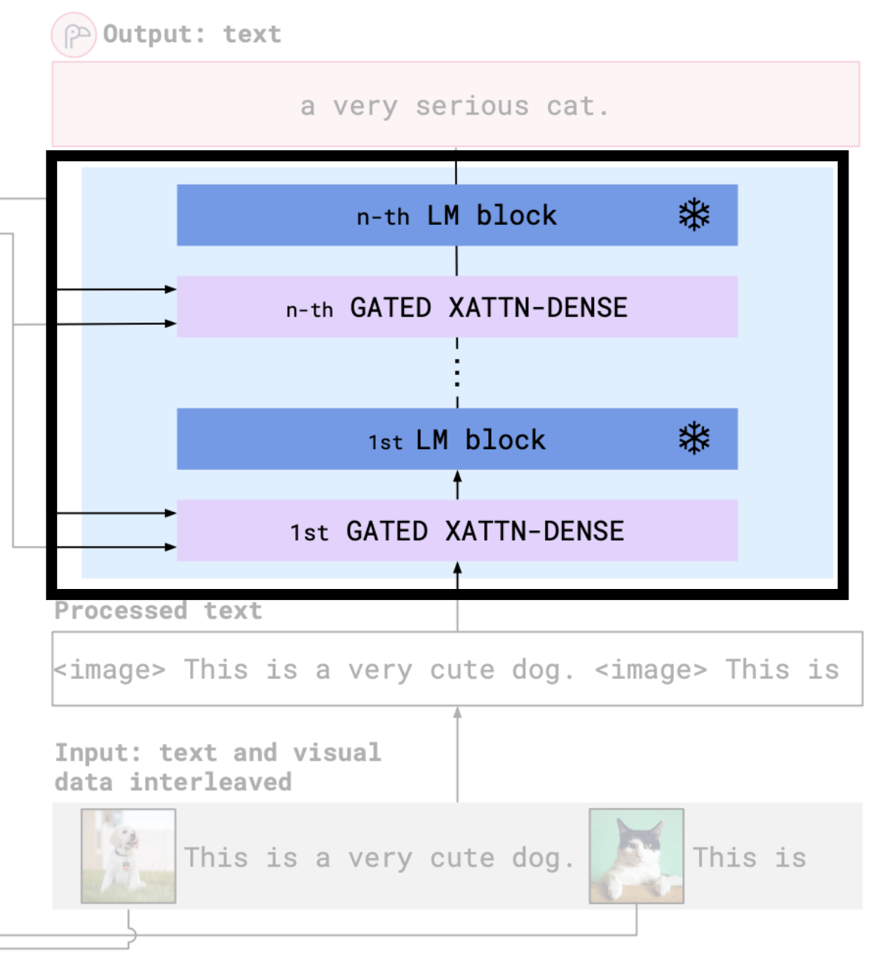
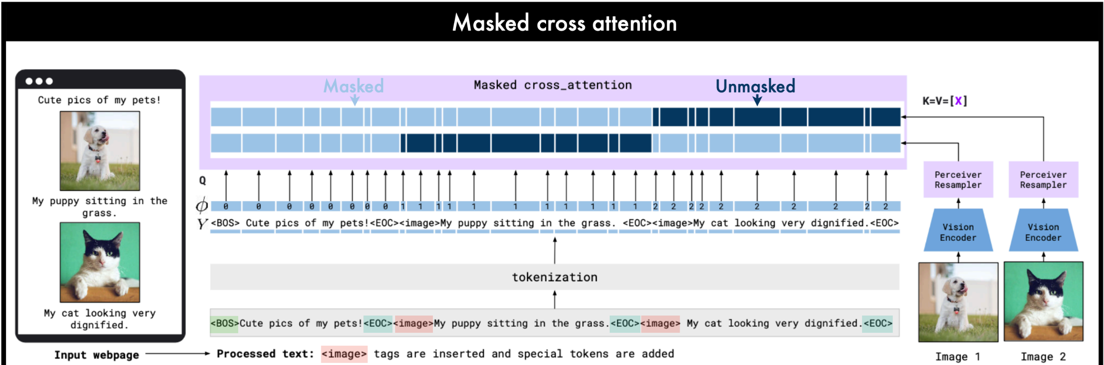
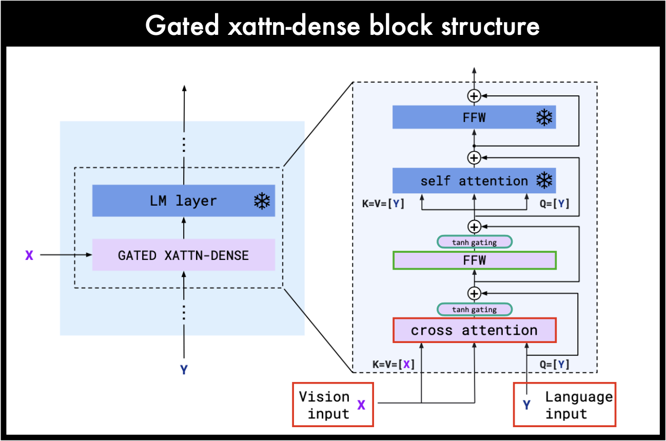
🦩 Model Architecture - Processing Language
Notes:
XAttn
How do we relate vision and text Cross Attention
Text -> queries which will attend to Perceiver output (image) -> keys and values
Causal masking over tokens from the perceiver resampler.
By default, each token only allowed to attend to the visual tokens of the image that appeared immediately before it.
condition language on some vision so for that we add a sequence of cross attention and a fit forward dense layer that we call cross attention dense
Gating
idea behind gating is that to learn a single parameter per layer
initialization those gates are closed and so that basically we are just equivalent to just having the language model at initialization and then during training those the model will slowly learn to kind of open those gates and slowly integrate the visual content
observe that this technique allows to avoid instability during training as well as improve the final performance of the mode
Interleaving
Interleaved XAttr and LM layer
Language models: frozen Chinchillas (trained on Massive Tex)
The output of the Chinchilla model is then decoded to get the text output

Slide 8
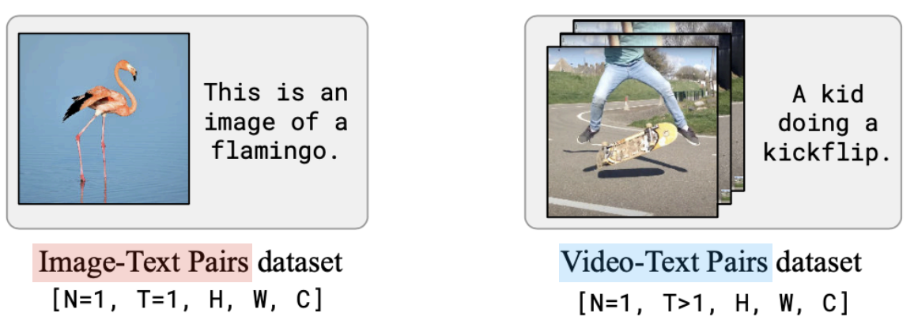
🦩 Datasets
MultiModel Massive Web (M3W)
- Extracted text and images from 43 million webpages
- M3W contains 185 million images and 182 GB of text.
- Text filter and image filters are used to remove low quality data.
- Removed non-English text docs
- Explicit image/video/text filter
- Remove images below 64 px or >1:3 aspect ratio or single color
Image resolution: 320 x 320
Text length: 256 tokens
Data Deduplication
- Deduplication enables LMs to emit less memorized text (10x), and faster training, better accuracy
- Flamingo uses an internal Google tool for deduplication - Nearest neighbour search via visual embeddings
- ALIGN and LTIP datasets were deduplicated against benchmark image-text datasets - ImageNet, COCO, VQAv2, Flickr30k, VisDial
Image-Text pairs data
- ALIGN dataset: 1.8 billion noisy image-text pairs, 12.4 text tokens per image on average.
- LTIP dataset: 312 million image-text pairs, 20.5 text tokens per images
- Image resolution: 320 x 320
- Text length: 32/64 tokens
Video-Text pairs data
- VTP dataset: 27 million short videos.
- Avg duration: 22 seconds
- Video resolution: 320 x 320
- Text length: 32 tokens
Notes:
Image-Text pairs data
- ALIGN dataset: 1.8 billion noisy image-text pairs, 12.4 text tokens per image on average.
- LTIP dataset: 312 million image-text pairs, 20.5 text tokens per image
- Image resolution: 320 x 320
- Text length: 32/64 tokens
Video-Text pairs data
- VTP dataset: 27 million short videos.
- Avg duration: 22 seconds
- Video resolution: 320 x 320
- Text length: 32 tokens
Noisy: weakly linked, duplicates
Deduplication: garbage in, garbage out
MultiModel Massive Web (M3W)
- Extracted text and images from 43 million webpages
- M3W contains 185 million images and 182 GB of text.
- Text filter and image filters are used to remove low quality data.
- Removed non-English text docs
- Explicit image/video/text filter
- Remove images below 64 px or >1:3 aspect ratio or single color
Image resolution: 320 x 320
Text length: 256 tokens

Slide 9
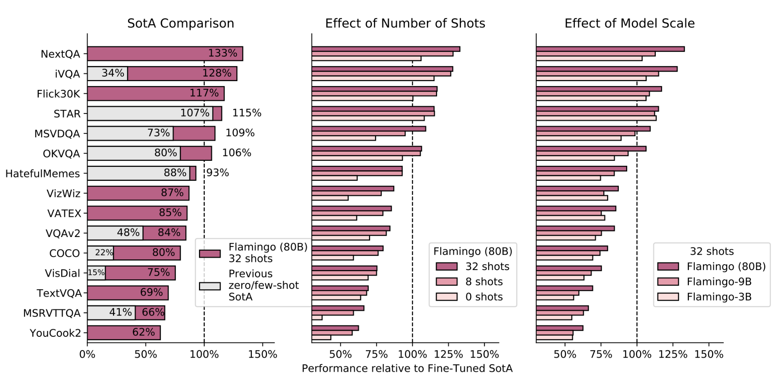
🦩 Experiments and Results
Notes:
Vertical dotted line is fine tuned SoTA - Flamingo better than fine-tuned SoTA in 6/15 tasks
Few shots vs Zero shot is generally better, but not always. See STAR and Hateful Memes
Larger models have better performance generally. All multi-modal datasets with image, videos and text

Slide 10
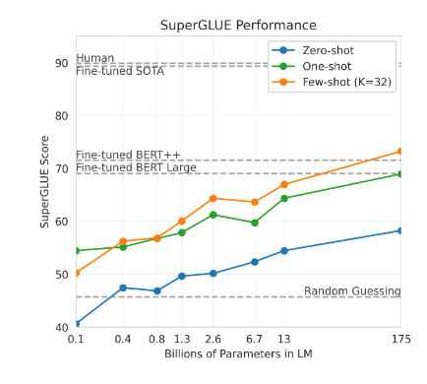
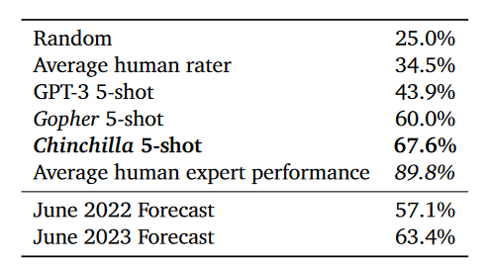
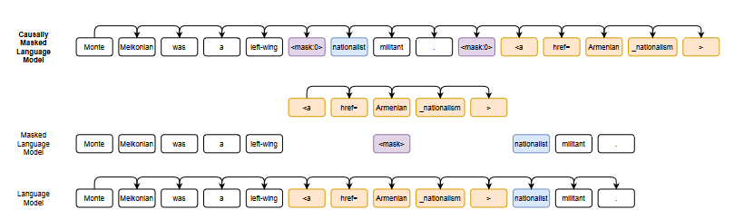
🦩 Related Work
Language Models are Few-Shot Learners, Brown et al., 2020
GPT-3 (and LLM) models are good at few-shot in-context learning, and get better with increasing size
Training Compute-Optimal Large Language Models, Hoffman et al., 2022
Produces a more accurate model (+7%) trained on 4x more data with same compute vs Gopher
Avg performance on 57 tasks in MMLU
CM3: A Causal Masked Multimodal Model of the Internet, Aghajanyan et al., 2022
Combine causal and BERT-style masking on lots of multimodal (HTML) data
Enables various unimodal and multi-modal tasks
Notes:
LM are few shot learners: In-context learning refers to learning from text-only examples provided as context. Very good zero-shot and few-shot scenario, without any fine-tuning. Graph shows fine-tuned GPT-3’s performance on Super GLUE benchmark, 32 examples per task * 8 tasks.
Training compute optimal LLMs: The 70B Chinchilla LM is frozen and used in Flamingo.
CM3: Causally masked approach generates tokens left to right while masking out a small number of long token spans that are generated at the end of the string, instead of their original positions.
Enables full generative modeling while also providing bidirectional context.
The resulting CM3 models can generate rich structured, multi-modal outputs while conditioning on arbitrary masked document contexts, and thereby implicitly learn a wide range of text, image, and cross modal tasks.

Slide 11
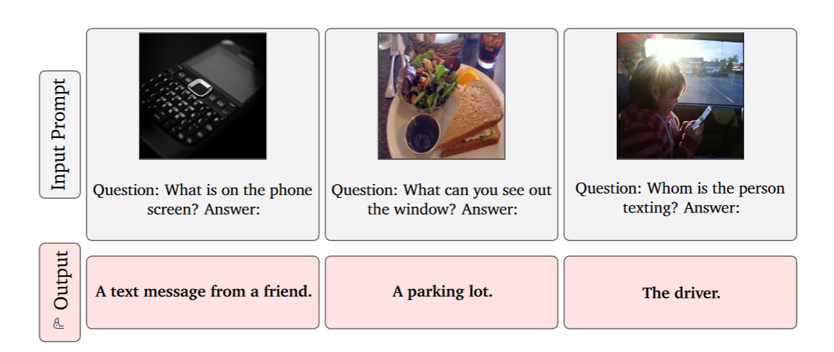
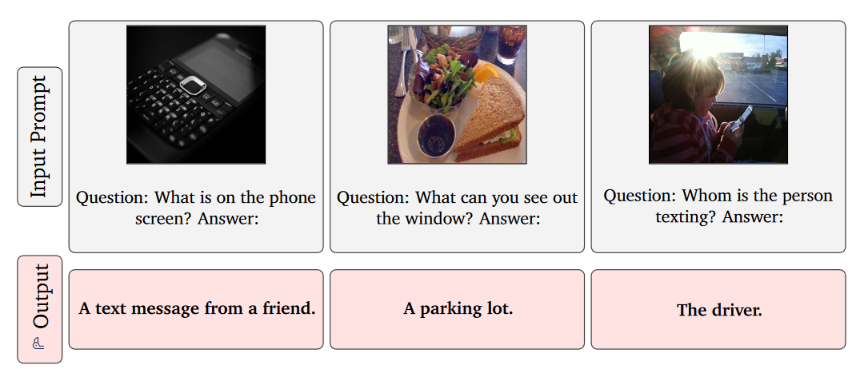
🦩 Limitations
Limitations of LLMs persist
Hallucinations and ungrounded guesses
Causal modeling of conditioning inputs is less expressive than bidirectional modeling
Transformer-based LMs perform worse on test sequences significantly longer than training ones
Poor classification performance
Although better at few-shot learning and open-ended generation capabilities, Flamingo lags behind contrastive models on classification tasks
Few-shot learning trade-offs
Inference compute cost increases quadratically with number of in-context inputs (linear if cached)
Sensitive to prompts
Performance plateaus as few-shot examples are >32
Notes:
In-context few-shot learning over gradient-based fine-tuning:
Requires no hyper-parameter tuning. Gradient based might overfit easily
Works well in low-data settings (dozens of examples). Gradient based needs more data

Slide 12
🦩 References
https://arxiv.org/pdf/2204.14198.pdf
https://cocosci.princeton.edu/papers/doing-more-with-less.pdf
https://mitpress.mit.edu/9780262631365/categorization-and-naming-in-children/
https://papers.nips.cc/paper/2020/hash/1457c0d6bfcb4967418bfb8ac142f64a-Abstract.html
https://arxiv.org/pdf/2201.07520.pdf
https://aclanthology.org/2022.acl-long.577.pdf

Slide 13
Thank You!
Questions? Team: Chirag, Mihir, Punith, Prince, Lavrenti

